Slide 1
Facebook for Neighborhood Groups
Thomasine Jackson, Presenter

Slide 17
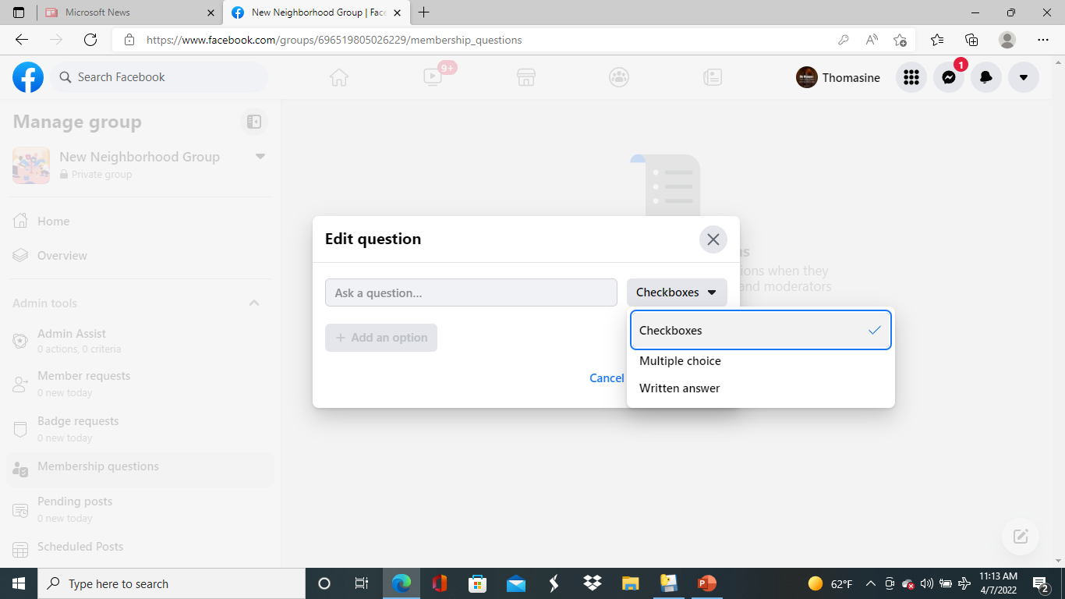

Slide 29
EDUCATIONAL CENTER IN FACEBOOK

